Slide 1
Grasmere Village Water Precinct
Mission Statement
Vision Statement

Slide 2
Grasmere VWP provide water distribution to residents in Grasmere. The water is purchased from Manchester
This is a story of one community using google to meet their asset management needs and the NHDES Grant requirements. We are going to look at a water system horizontal assets.
WE are going to look at the inventory, work order system, digital records and Asset Management Worksheet

Slide 3
The Distribution SYSTEM
Grasmere Water System

Slide 4
The LOS workshop goals are as follows:LoS Matrix
· Identify the LOS that the organization delivers to its customers in wastewater and stormwater collection systems.
· Identify the key performance indicators that provide a meaningful measurement of how well those levels are being met.
· Establish performance targets considering the trade-offs between level of service and cost of service.
· Develop a communication plan for customers regarding these LOS and how your organization is addressing them.
· Train the staff on general asset management concepts and the importance of LOS in creating an effective asset management program.

Slide 5
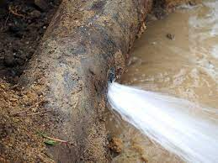
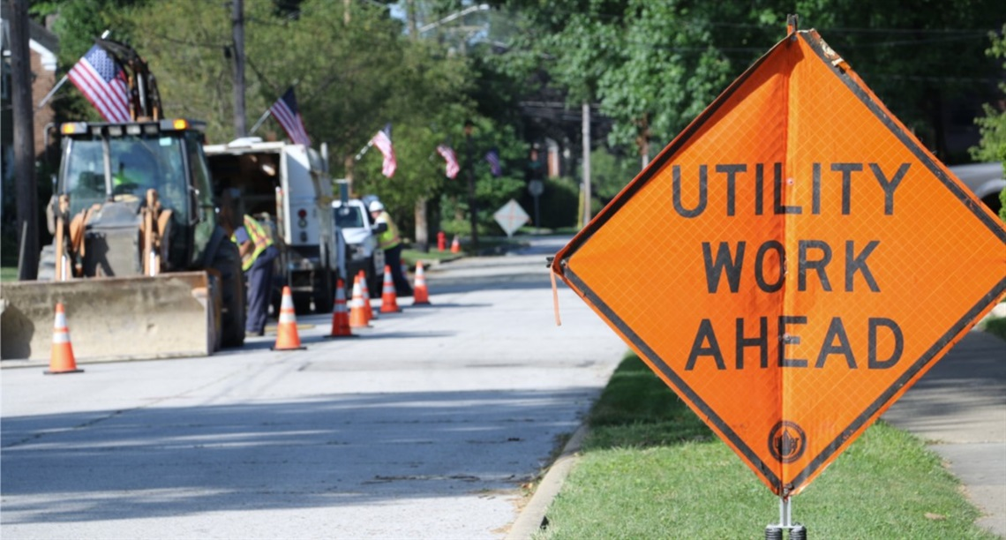
Developing Financial projection for capital needs based on age and useful life
Understanding your system and planning for its needs. Keeping the lowest lifetime cost for each asset and protecting the customers from unstable rate increase
AM worksheet

Slide 6
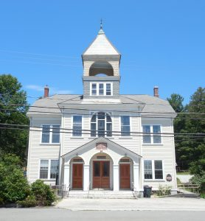
Implementation of Google Tools for Grasmere Village Water Precinct
Involves setting the system up training and the use of the program
Go to training video

